Slide 1
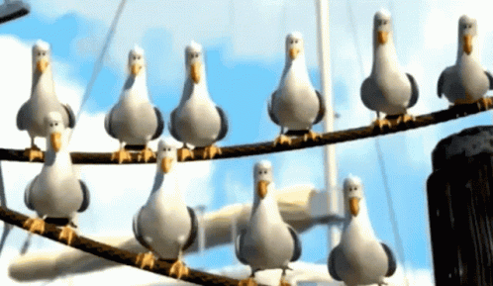
Possessive pronouns

Slide 2
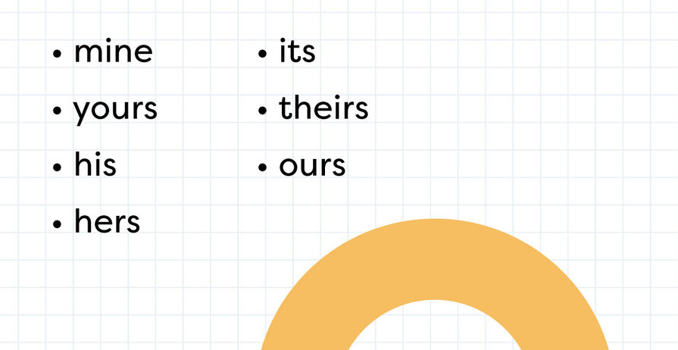
Possessive pronouns
Possessive pronouns show ownership and possession.

Slide 3
Circle the possessive pronoun in each sentence.
This bag is mine.
That coat is hers.
The blue car is his.
The big house on the corner is ours.
The toys on the floor are theirs.
Is this pencil yours?

Slide 4
Questions
Find the possessive pronoun in this sentence.
Emma’s pencil case is actually yours.
A) Emma
B) pencil
C) actually
D) yours

Slide 5
Questions
Put in a suitable possessive pronoun.
That is James’ bike, that bike is _________________.

Slide 6
Questions
Put in a suitable possessive pronoun.
This classroom belongs to us, this classroom is __________.

Slide 7
Independent task
Stick the sheet in
Complete it
Get it marked
Move onto practise SATS questions

