Slide 1
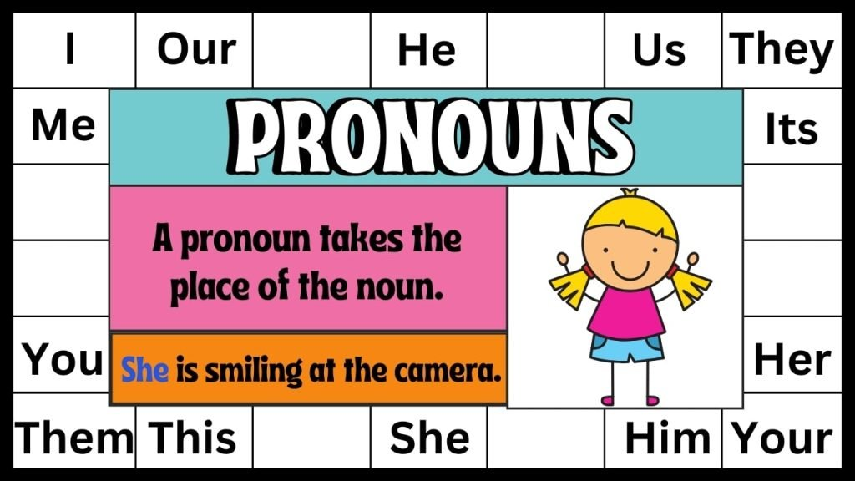
Pronouns

Slide 2
Pronouns
Pronouns replace nouns:
Daniel walked to the park. Daniel played on the swings. Daniel saw Josh. Daniel and Josh went on the slide.
TOO MUCH DANIEL
Change it to the following:
Daniel walked to the park. He played on the swings. Daniel saw Josh. They went on the slide.

Slide 3
What are our pronouns?
I
You
He
She
It
We they
Me
Him
Her
It
Us
Them

Slide 4
Replace the bold word with the correct pronoun.
This present is for James and me. → This present is for ___ .
Mrs Carter asked Liam and me to help. → ___ asked Liam and me to help.
The headteacher spoke to Ava and him. → The headteacher spoke to ___ .
The children cleaned the classroom. → ___ cleaned the classroom.
That house belongs to my sister and I. → That house belongs to ___ .

Slide 5
Replace the bold word with the correct pronoun.
Tom went to the park. → ___ went to the park.
I saw Sarah at the shops. → I saw ___ at the shops.
The dog was barking loudly. → ___ was barking loudly.
This is Jack and me. → This is ___ .
The books are on the table. → ___ are on the table.

Slide 6
Choose the correct pronoun
This present is for (I / me).
(We / Us) are going to the cinema.
The coach gave the trophy to (he / him).
That bike belongs to (she / her).
(They / Them) finished their homework early.

Slide 7
Questions
Which word is the pronoun in this sentence?
Sarah said she would help later.
A) Sarah
B) she
C) help
D) later

Slide 8
Questions
Replace the underlined word or words in the sentence below with the correct pronouns.
Marc said Marc would bring the doughnuts for his parents and he
would give his parents one of each colour.

Slide 9
Independent task
Stick the sheet in
Complete it
Get it marked
Move onto practise SATS questions

