Slide 1
Reasoning – 2 mark addition and subtraction

Slide 2
Best piece of advice – if it is 2 marks, you need to do at least 2 things

Slide 3
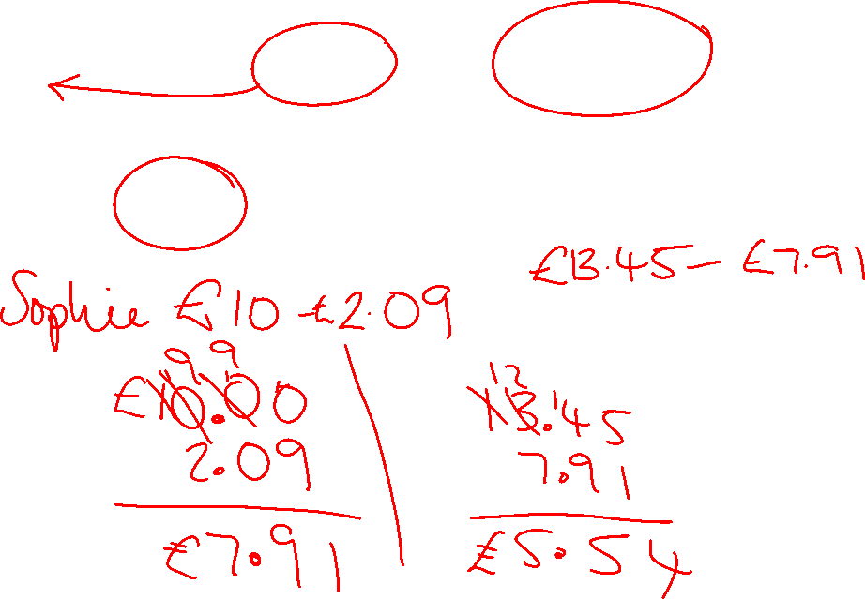
Sophie and Jane each buy a cake.
Sophie pays with a £10 note and gets £2.09 change.
Jane's cake cost £13.45.
How much more does Jane's cake cost than Sophie's cake?
​
Turn it into an arithmetic question

Slide 4
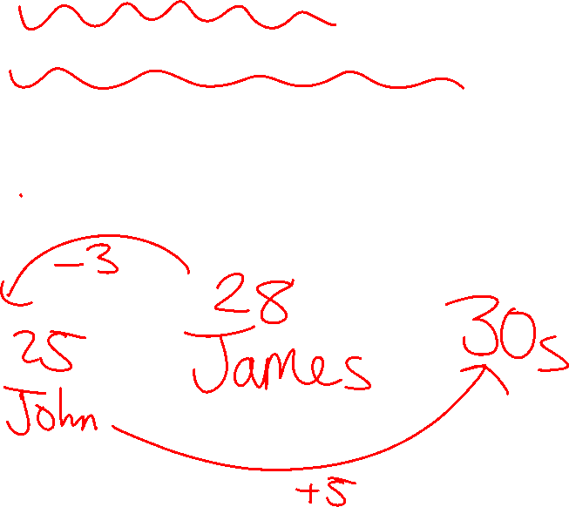
John, James and Josh run a race.
James' time is 28 seconds.
John's finishes 3 seconds before James.
Josh finishes 5 seconds after John.
What was Josh's time in seconds?
​
Draw a timeline

Slide 5
At the start of May, there were 2,456 boxes of toys in the shop.
During May,
3267 more boxes of toys were delivered
1279 boxes of toys were sold.
How many boxes of toys were left in the shop at the end of May?
​
What is the key vocabulary telling me?

Slide 6
St Katherin's school is raising money for charity.
They raised £45.67 at a bake sale.
They raised £37.09 at a car wash.
Their target is £420.
How much more do they need to reach their total?
​
What are my two calculations?

