Slide 1
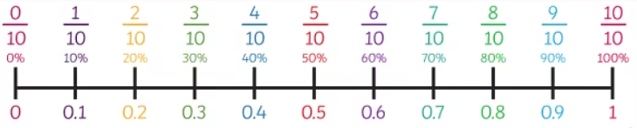
Modal verbs

Slide 2
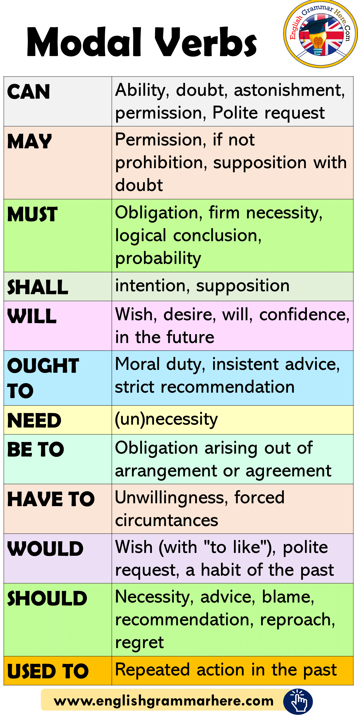
Modal verbs
Modal verbs indicate the possibility of whether something is likely to happen.

Slide 3
Circle the modal verb in each sentence below.
They should listen carefully in class.
I can swim very fast.
He might win the race.
We will visit Grandma tomorrow.
She cannot find her shoes.
You ought to try your best.
They couldn’t believe their eyes.

Slide 4
Which sentence below is most likely to happen?
James will arrive soon.
James may arrive soon.
James might arrive soon.
James should arrive soon.

Slide 5
Questions
Find the modal verb in this sentence.
She could run quickly through the woods
a) run
b) could
c) through
d) quickly

Slide 6
Questions
Which sentence uses a modal verb to show possibility?
a) She runs every morning.
b) She might come later.
c) She came early.
d) She is running.

Slide 7
Questions
Which modal verb best completes the sentence?
You ______ finish your homework before watching TV.
a) can
b) might
c) must
d) could

Slide 8
Independent task
Stick the sheet in
Complete it
Get it marked
Move onto practise SATS questions

