Slide 1
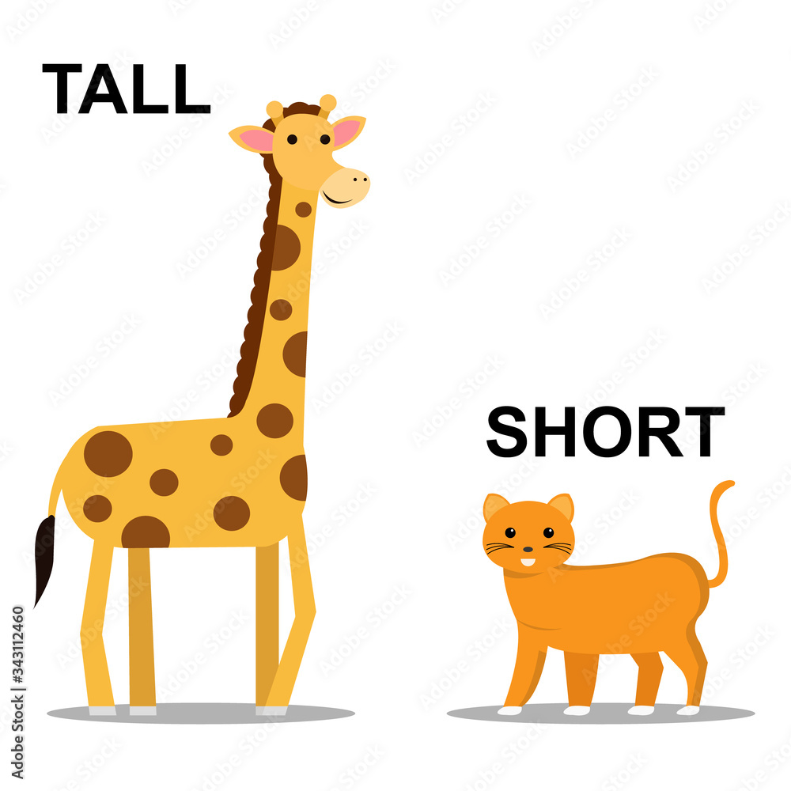
Contracted form

Slide 2
Contracted form
It is the shortened version of words or phrases
The contraction is typically shown by an apostrophe
I am I'm
cannot can't
do not don't

Slide 3
The rules
When contracting forms these usually apply:
not | 't
had / would | 'd
will | 'll
have | 've
are | 're
is | 's

Slide 4
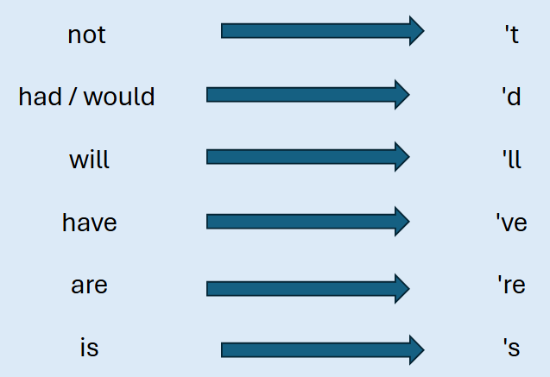
What are the contractions of the words below?
I had
you will
were not
will not
must have
was not
will not
it is
nobody is

Slide 5
What are the contractions of the words below?
I have
Tom will
have not
you have
what will
shall not
that is
would not
let us

Slide 6
Questions
Which sentence uses a contraction correctly?
A. She cant come to the party.
B. She can’t come to the party.
C. She cant’ come to the party.
D. She can,t come to the party.

Slide 7
Questions
Rewrite the sentence using a contraction.
I will finish my homework later.

Slide 8
Questions
Underline the contraction in this sentence.
She’s going to the library after school.

Slide 9
Questions
What contraction could replace the underlined words?
They are not coming to the party.

Slide 10
Independent task
Stick the sheet in
Complete it
Get it marked
Move onto practise SATS questions

