Slide 1
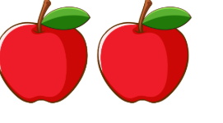
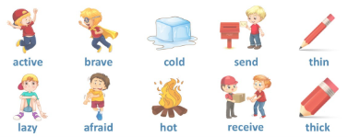
Synonyms and antonyms

Slide 2
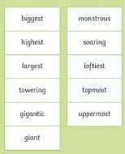
Synonyms
Synonyms are words that mean the SAME
So, if I wanted synonyms for tall, I could have

Slide 3
On your whiteboards
Write 3 synonyms for
Beautiful
Small
Tired

Slide 4
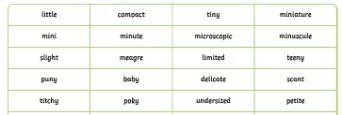
Antonyms
Antonyms are words that mean the OPPOSITE
So, if I wanted antonyms for tall, I could have

Slide 5
On your whiteboards
Write 3 antonyms for
Beautiful
Small
Tired

Slide 6
Questions
Which word is synonym to the word in bold?
The kitten was very tiny.
huge
B. small
C. loud
D. slow

Slide 7
Questions
Which word is the antonym to the word in bold?
The road was wide.
long
B. narrow
C. smooth
D. steep

Slide 8
Questions
Circle the word that is a synonym as the word in bold.
The instructions were clear.
confusing
B. simple
C. hidden
D. boring

Slide 9
Questions
Write an antonym for the word in bold.
The glass is full. The other glass is ______.
The puzzle was easy, but the next one was ______.
The room was very dark, so she turned on the light to make it ______.

Slide 10
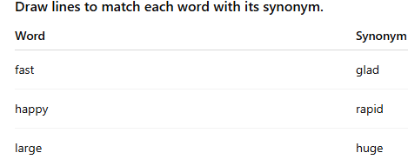
Questions

Slide 11
Independent task
Stick the sheet in
Complete it
Get it marked
Move onto practise SATS questions

