Slide 1
Multiplying by 10, 100, 100

Slide 2
When we see the following:
____ X 10 =
____ X 100 =
____ X 1000 =
10 X ___ =
100 X ___ =
1000 X ___ =
What do we draw?

Slide 3
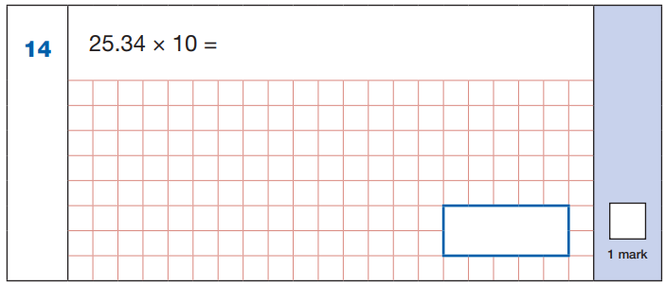

Slide 4
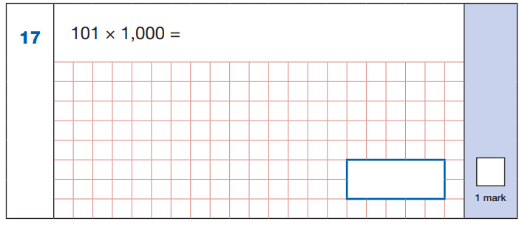

Slide 5
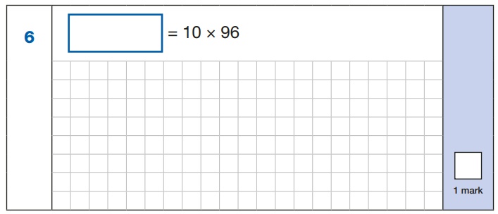

Slide 6


