Slide 1
Dividing by 10, 100, 100

Slide 2
When we see the following:
____ ÷ 10 =
____ ÷ 100 =
____ ÷ 1000 =
What do we draw?

Slide 3
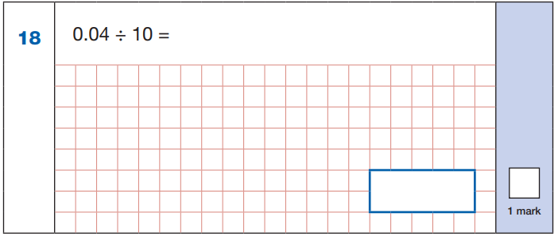

Slide 4
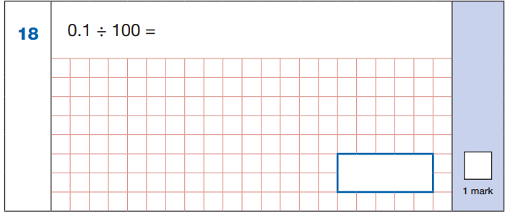

Slide 5
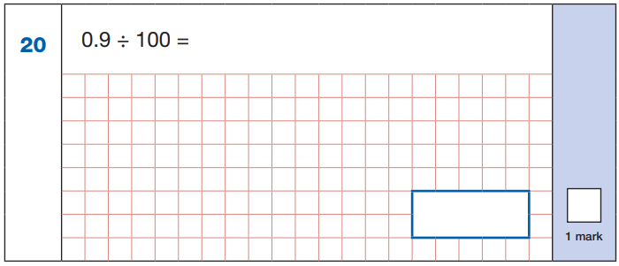

Slide 6


