Slide 1
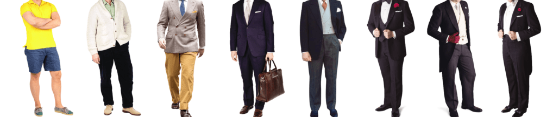
Formality

Slide 2
Formality
Levels of formality
It is casual with your friend and family
Or is it a meeting with the King, an important meeting

Slide 3
Which word is more formal?
Told or instructed
children or kids
obtain or get
get or discover
broke down or failed

Slide 4
Sometimes it might ask which sentence is the most formal
I’m really sorry I can’t come to the meeting.
Sorry, but I can’t make it.
I regret that I am unable to attend the meeting.
I can’t come to the meeting.
Think back – level of formality.
Is it with friends or with the King?

Slide 5
Sometimes it might ask which sentence is the most formal
The experiment didn’t work because we messed up.
The experiment failed because an error occurred.
The experiment didn’t work because something went wrong.
The experiment went wrong because we messed up.
Think back – level of formality.
Is it with friends or with the King?

Slide 6
Questions
Which sentence is the most formal?
A. Lots of people turned up to the event.
B. A large number of people attended the event.
C. Loads of people came to the event.
D. Tons of people showed up.

Slide 7
Questions
Which sentence is the most formal?
A. We’re going to look into the problem soon.
B. We will investigate the problem shortly.
C. We’ll check the problem later.
D. We’re gonna sort the problem out.

Slide 8
Questions
Rewrite the phrase in bold with a more formal phrase.
The company will look into the complaint.

Slide 9
Questions
Which sentence is the most formal?
A. The project was put off.
B. The project got delayed.
C. The project was postponed.
D. The project was pushed back.

Slide 10
Independent task
Stick the sheet in
Complete it
Get it marked
Move onto practise SATS questions

