Slide 1
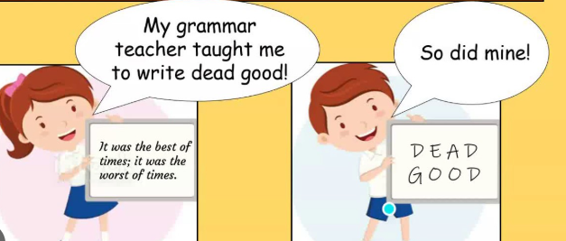
Standard English

Slide 2
Standard English
Standard English uses the correct grammatical rules and is regarded as the polite or most formal.
It avoids slang and colloquialisms.
Think – how would Mrs Craven and Mrs Jones say it?
We done it We finished it
TOP TIP
Read it aloud or ask an adult to read it.

Slide 3
Which uses Standard English?
well done or nice one guys
hiya or good morning
We went NASA last year or We visited NASA last year
Them scientists are ace. or Those scientists are ace.
I done it or I have finished it.

Slide 4
Sometimes we need to remember our grammatical rules
was or were
'Was' is for singular and 'were' is for plural
We _________ going to the park.
I ____________ going to the park
is or are
Is for singular and 'are' is for plural
He __________ calm.
They _________ calm.

Slide 5
Questions
Which sentence is written in Standard English?
A. She done her homework already.
B. She did her homework already.
C. She done did her homework.
D. She do her homework already.
TOP TIP
Read it aloud or ask an adult to read it.

Slide 6
Questions
Rewrite the sentence so it is in Standard English.
He ain’t got any pencils.
TOP TIP
Read it aloud or ask an adult to read it.

Slide 7
Questions
Tick the sentence written correctly in Standard English.
A. I seen that film before.
B. I have saw that film before.
C. I have seen that film before.
D. I seened that film before.
TOP TIP
Read it aloud or ask an adult to read it.

Slide 8
Questions
Tick the sentence written in Standard English.
A. Them books are mine.
B. Those books are mine.
C. Them books is mine.
D. Those books is mine.
TOP TIP
Read it aloud or ask an adult to read it.

Slide 9
Independent task
Stick the sheet in
Complete it
Get it marked
Move onto practise SATS questions

