Slide 1
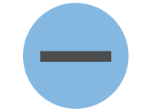
Dash and dashes

Slide 2
Dash
Dashes are used to add extra information like commas and brackets.
HOWEVER
Dashes are SPECIAL! They can be used on their own or in pairs.

Slide 3
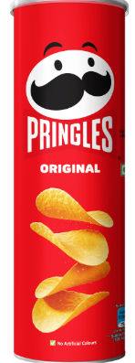
Dash
If it is SINGLE and asking for ONE dash, the extra information will be near the end of the sentence.
TOP TIP – find the main clause first. Remember this makes sense
She had been waiting all day for one thing the bus.
There was only one thing left to do run.
I opened the box it was empty.

Slide 4
Where would the dash go in these sentences?
There was only one person who knew the answer and it wasn't me!
He finally understood the truth he had been wrong all along.
There was only one problem we were lost.
The answer was simple everyone had forgotten the key.
He had finally reached the finish line his greatest achievement.

Slide 5
Dashes
If it is asking for DASHES, or a PAIR of dashes, the extra information will be in the middle of the sentence like a relative clause.
My dog a golden retriever loves swimming.
The teacher Mrs Brown gave us extra homework today.
The Amazon rainforest – the largest rainforest in the world is home to millions of species.
TOP TIP – we can cover up the extra information and the main clause should make sense.

Slide 6
Where would the pair of dashes go in these sentences?
The cheetah the fastest land animal can run at incredible speeds.
The volcano which had been quiet for years suddenly erupted.
Our school football team the current league champions won again yesterday.
The giraffe the tallest land animal can reach leaves high in trees.

Slide 7
Questions
Insert a pair of dashes into the sentence below.
My sister who is a doctor works in London.

Slide 8
Questions
Insert a pair of dashes into the sentence below.
The tiger the largest species of cat is a powerful predator.

Slide 9
Questions
Insert a dash in the sentence below.
She had been practising for months for this moment the final performance.

Slide 10
Questions
Insert a dash in the sentence below:
There was only one sound in the forest the hooting of an owl.

Slide 11
Independent task
Stick the sheet in
Complete it
Get it marked
Move onto practise SATS questions

