Slide 1
Conjunctions

Slide 2
Conjunctions
There are two types of conjunction:
Co-ordinating conjunctions Subordinating conjunctions

Slide 3
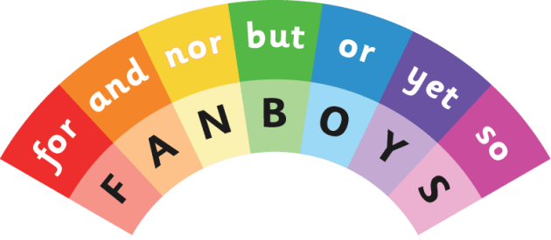
Co-ordinating conjunctions
They connect a main clause to a main clause.
There are only 7!

Slide 4
Find the coordinating conjunctions in the sentences below.
I wanted to go outside but it started to rain.
She loves reading and she visits the library every week.
We were tired, so we went to bed early.
You can have tea or you can have juice.
She didn’t call nor did she send a message.
It was late yet they were still awake.

Slide 5
Insert an appropriate coordinating conjunction in the sentences below.
I was tired ________ I went to bed early.
She likes maths _______ she doesn’t like science.
We can go to the park ___________ we can stay at home.
It was cold ____________ he forgot his coat.
He didn’t eat his lunch _________ was he hungry.
I opened the window ____________ it was very hot.

Slide 6
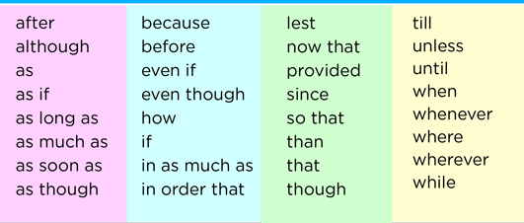
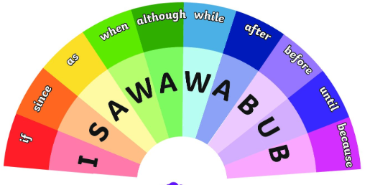
Subordinating conjunctions
They start a subordinating clause – these do not make sense on their own.

Slide 7
Find the subordinating conjunctions in the sentences below.
I went inside because it started to rain.
When the bell rang, the children lined up.
She wore a coat although it wasn’t very cold.
We will go to the park if it stays sunny.
He was happy since he won the game.
After we finished dinner, we watched a film.
You can’t go out unless you finish your homework.

Slide 8
Insert an appropriate subordinating conjunction in the sentences below.
I stayed inside _______ it was raining.
________ you finish your homework, you can watch TV.
She was happy ________ she passed the test.
________ the bell rang, the children went outside.
We won’t go to the park ________ it stops raining.
He went to bed early __________ he was tired.
________ we had eaten dinner, we watched a film.

Slide 9
However, if it states ‘conjunction’ it could be either!
Identify the conjunction in the sentences below.
I wanted to play outside, but it was raining.
She stayed at home because she was ill.
We can go now, or we can wait until later.
When the teacher arrived, the class became quiet.
He was tired, so he went to bed.
Although it was late, they kept playing.

Slide 10
Questions
Identify the conjunction in the sentence below.
You can have cake or ice cream.

Slide 11
Questions
Which conjunction best fits the sentence below?
____________ he was late, he still got a seat.
a) Although
b) And
c) So

Slide 12
Questions
Which sentence uses a subordinating conjunction?
I ran fast, and I won the race.
I ran fast because I wanted to win.
c) I ran fast, so I won the race.

Slide 13
Questions
Insert a suitable subordinating conjunction.
__________ you finish your work, you can go outside.

Slide 14
Independent task
Stick the sheet in
Complete it
Get it marked
Move onto practise SATS questions

