Slide 1


Colons and semi colons

Slide 2
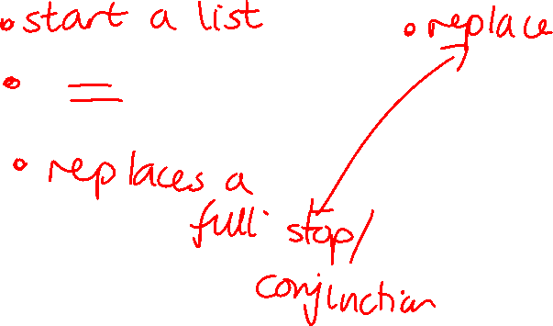
What are the jobs for colons and semi colons?
Colons | Semi colons

Slide 3
Today we are looking at marking the boundary between independent clauses
We know a colon and a semi colon can replace a full stop.
For example:
It was raining heavily; the match was cancelled.
He knew the answer: he had revised carefully.
We want to connect the sentences as they are closely related so we are looking for where the full stop would go

Slide 4

Where could a colon or semi colon go in the sentences below?
Finishing my homework meant one thing I could watch television.
The sun was shining we decided to go to the park.
She was very tired she still finished the race.
He loves reading his sister prefers drawing.

Slide 5
Questions
Insert a semi colon in the correct place in the sentence below.
I went home I ate dinner.

Slide 6
Questions
Insert a semi colon in the correct place in the sentence below.
She studied hard she passed the test

Slide 7
Questions
Insert a colon in the correct place in the sentence below.
She was nervous she still gave a great speech

Slide 8
Questions
What piece of punctuation could go in the box below?
The wind was strong the trees bent in the storm.

Slide 9
Independent task
Stick the sheet in
Complete it
Get it marked
Move onto practise SATS questions

