Slide 1
Hyphenated words

Slide 2

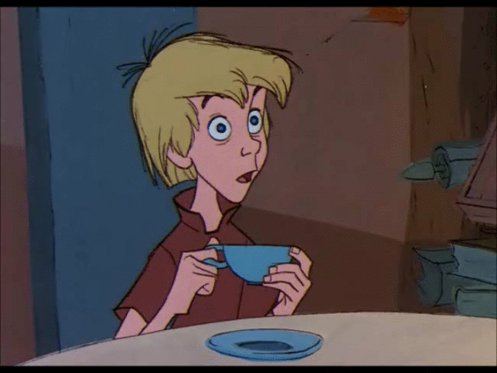
Hyphens
Hyphens are used to connect words to avoid confusion.
For example:
She stared wide eyed.
1) In this sentence her eyes are wide apart from each other.
She stared wide-eyed.
2) In this sentence, her eyes are open wide as it means she is shocked

Slide 3
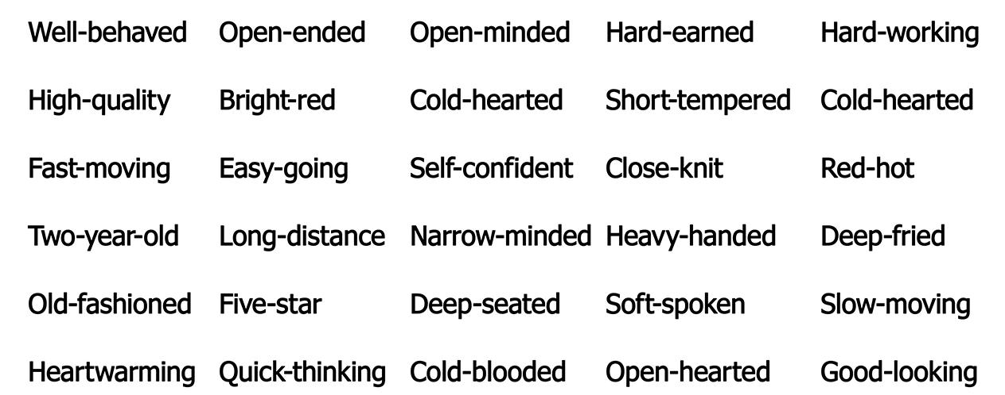
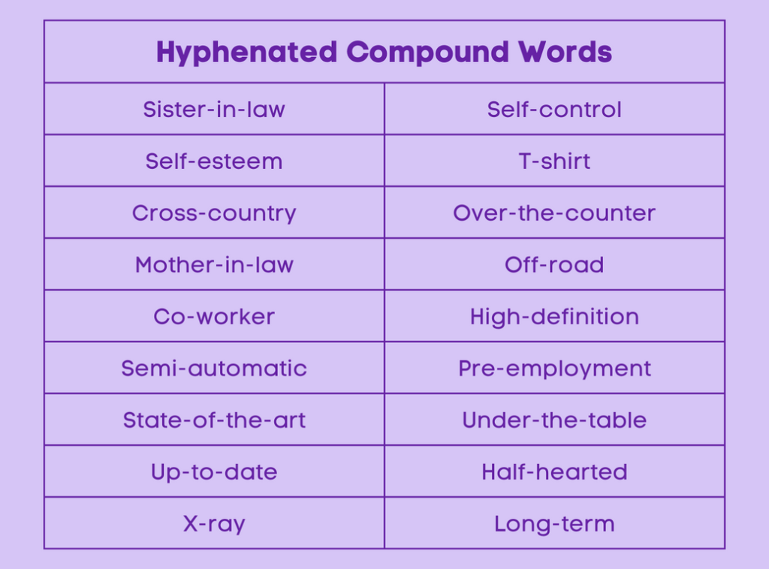
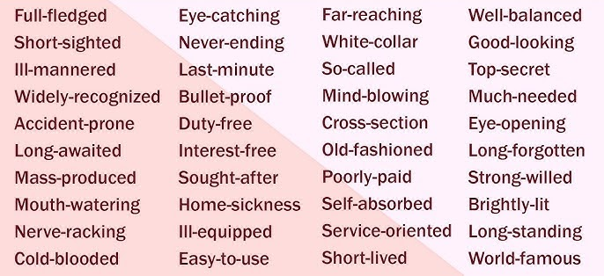
Here are some common hyphenated words

Slide 4
HINT
Look for the words where we could get confused – look below, where could the reader be unsure of the meaning?
The man eating crocodile was dangerous.

Slide 5
Insert a hyphen in the correct place in the sentences below.
She adopted a well trained puppy.
She gave a long term solution.
They stayed in a five star hotel.
He made a world famous painting.
The teacher gave a thought provoking question.
It was a record breaking performance.

Slide 6
Questions
Insert a hyphen in the correct place in the sentence below.
She is a kind hearted person.

Slide 7
Questions
Insert a hyphen in the correct place in the sentence below.
They went on a once in a lifetime trip.

Slide 8
Questions
Insert a hyphen in the correct place in the sentence below.
They saw a deep sea creature.

Slide 9
Questions
Insert a hyphen in the correct place in the sentence below.
It was a never ending story.

Slide 10
Independent task
Stick the sheet in
Complete it
Get it marked
Move onto practise SATS questions

