Slide 1
Simple tense

Slide 2
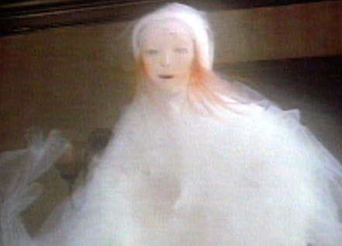
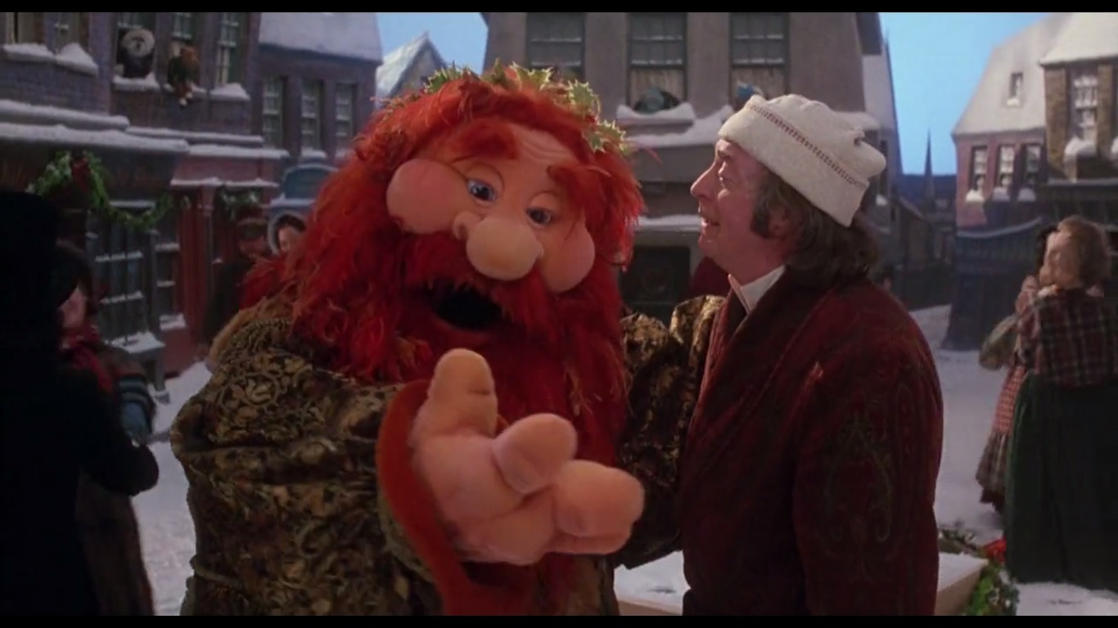
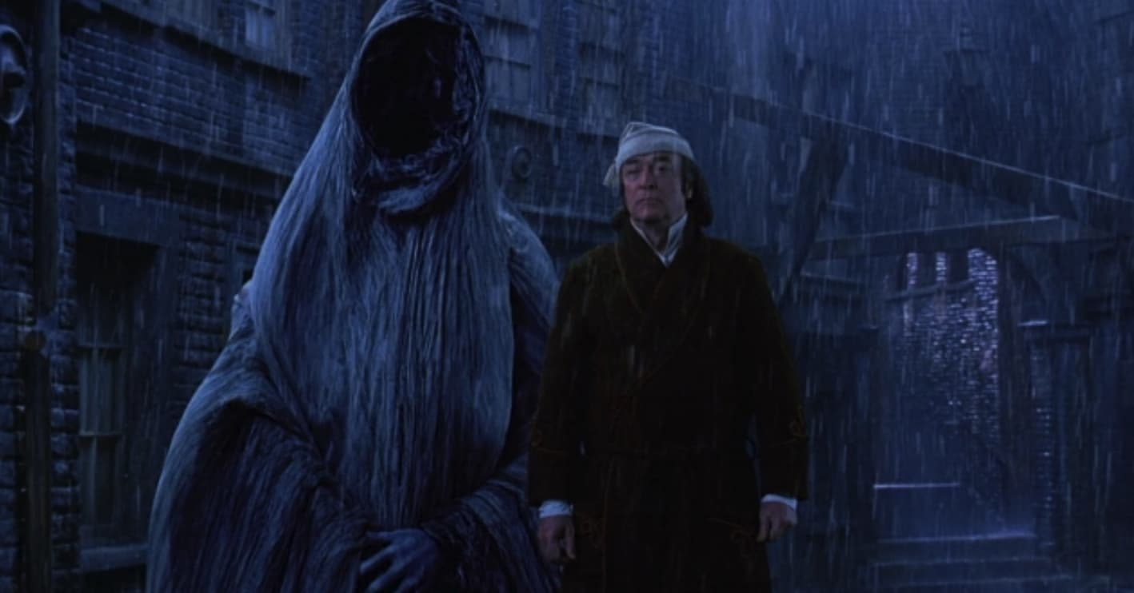
Simple tense
The simple tense has three parts:
Simple past
Simple present
Simple future

Slide 3
Simple past
The simple past tense describes a completed activity that happened in the past.
In other words, the activity started in the past and ended in the past.
It has a name/pronoun and the verb in its basic past form.
He ran.
She saw.
They swam.
John walked.

Slide 4
Simple present
The simple present tense describes an activity happening now.
It has a name/pronoun and the verb in its basic past form.
He swims.
They walk.
She studies.
I play.
John works.
They help.

Slide 5
Simple future
The simple future tense is used for an action that will occur in the future. For example:
I will go.
They will see.
Jane will run.
He will swim.

Slide 6
Complete the sentence in the simple past using the verb form in brackets.
She ______________ to school. (walk)
They _______________ their lunch. (eat)
I _______________ on the swings. (play)
He ______________________ to the park. (go)
James _____________ out the candle. (blow)

Slide 7
Complete the sentence in the simple past using the verb form in brackets.
The bird ______________ to its nest. (fly)
The flowers _______________ in the greenhouse. (grow)
She _______________ her coat on the pegs. (hang)
He ______________________ let’s go to the park. (say)
James _____________ the candle. (take)

Slide 8
Questions
Use the verb given to write the sentence below in the simple past tense.
She ____________________ her lunch.
eat

Slide 9
Questions
Use the verb given to write the sentence below in the simple past tense.
They ____________________ beautiful songs.
sing

Slide 10
Questions
Use the verb given to write the sentence below in the simple past tense.
They ____________________ at the park
be

Slide 11
Questions
Use the verb given to write the sentence below in the simple past tense.
Harry ____________________ the ball
catch

Slide 12
Questions
Use the verb given to write the sentence below in the simple past tense.
She ____________________ a poem.
write

Slide 13
Independent task
Stick the sheet in
Complete it
Get it marked
Move onto practise SATS questions

