Slide 1
Multiplying by decimals
Top TIP – DO NOT fill with place holders!

Slide 2
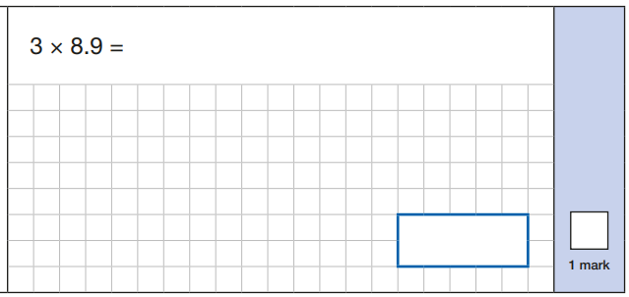

Slide 3
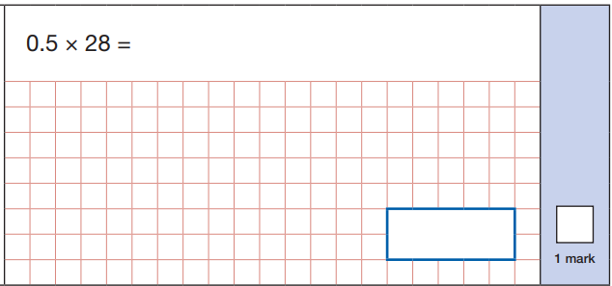

Slide 4
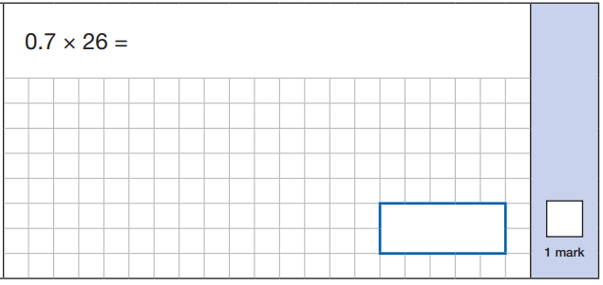

Slide 5
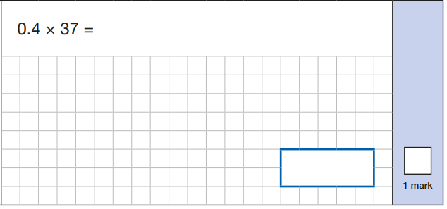

Slide 6


