Slide 1
Reasoning – Time

Slide 2
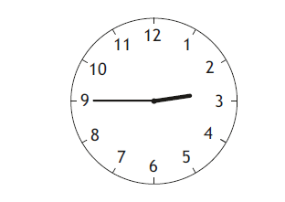
What is the time here in 12 hour and 24 hour?
Remember
Short hand = hours
Long hand = minutes (count in 5s)

Slide 3
James looked at his watch below.
He has an appointment at 17:05.
How long has he got to wait?
Remember - number line!

Slide 4
James looked at his watch below.
He left his house at 12:35.
How long ago did he leave?
Remember - number line!

Slide 5
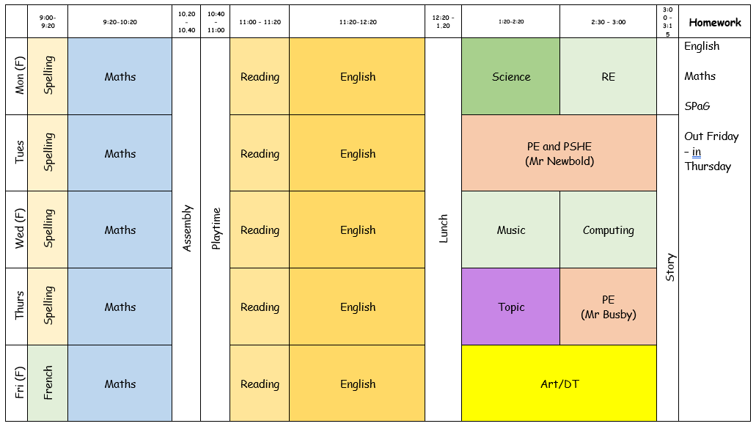
Here is a school timetable.
How long do they spend doing reading?
How long do they spend at lunch and at playtime?

